Slide 1



Learning to Fuse Music Genres
with Generative Adversarial Dual Learning
Zhiqian Chen, Chih-Wei Wu, Yen-Cheng Lu, Alexander Lerch, Chang-Tien Lu
Department of Computer Science, Virginia Tech
Center for Music Technology, Georgia Institute of Technology

Slide 2

Paper
Presentation Agenda
Motivation
Method
Evaluation
Demo
How to be creative?
Examples
GAN extension
Domain fusion
Quantitative study
Listening test
Q & A

Slide 3
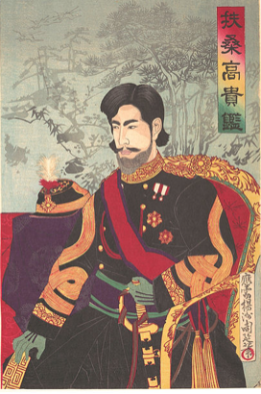
Motivation
How to be creative?
Fuse ideas
Art workers
Example
Combining things that don't normally go together.
Drawing a picture by imitation w/ fusion
Vincent Van Gogh imitating Japanese art (ukiyo-e)
early paintings
later paintings
ukiyo-e

Slide 4
Motivation
How to be creative?
Fuse ideas
Researcher
Ph.D. student
Combining things that don't normally go together.
Writing a paper by imitation w/ fusion
Get an idea after reading a lot of papers

Slide 5

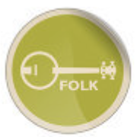
Motivation
Music generation problem
Problem
Challenge
Related work
Solution
Create new music after listening to music of different genres.
How to combine the ideas of listened music in an unsupervised fashion?
Domain transferring, rather than combining
Generative adversarial networks (GAN) extension

Slide 6
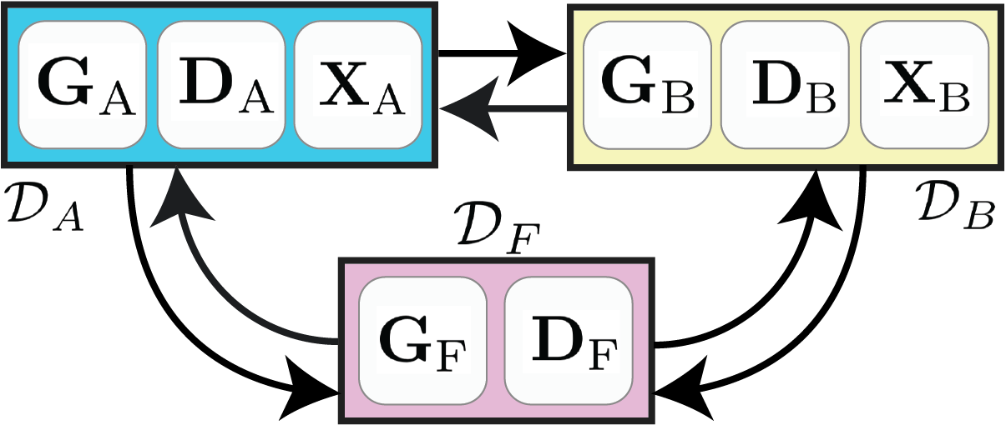
Method
Fusion GAN
Problem settings
Three domains:
Domain A/B: given music
Domain F: generated music
Components of GAN
G/D:Generator / Discriminator
X_a/X_b: Data
Task
Learn a balanced distribution from X_a / X_b

Slide 7
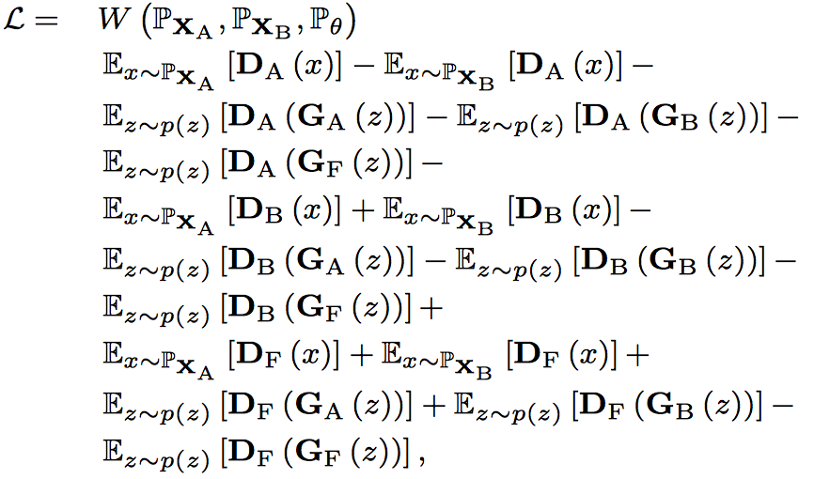
Method: Fusion GAN
Global loss function
From the perspectives of each D
=

Slide 8
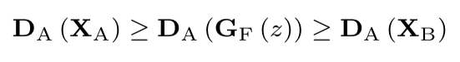
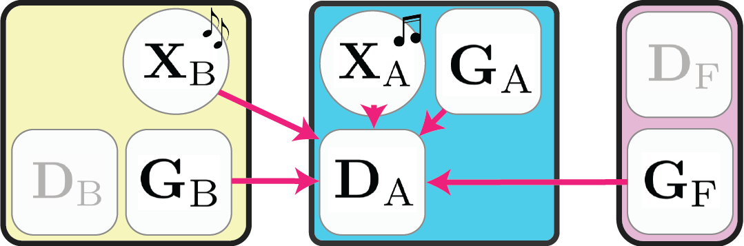
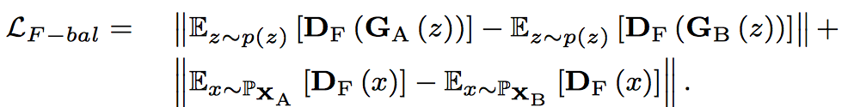
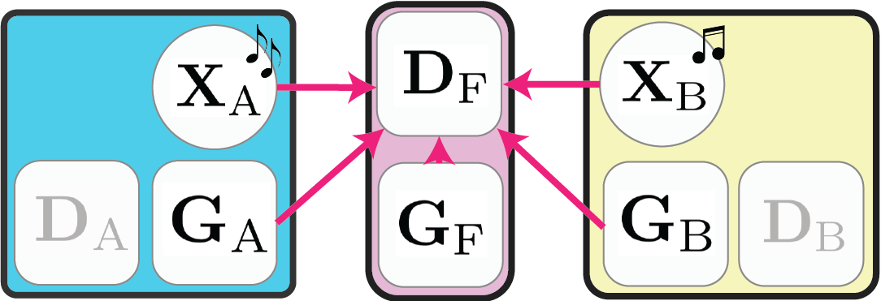
Method: Fusion GAN
Balance constraint: perfect mix is half-half
Domain A
Domain F：keep same distance from A and B
FusionGAN Optimality Theorem
convergence guarantee

Slide 9
Evaluation
Quantitative Study
Music Genres Intrinsic property
Normalized Pitch Distribution (NPD)
Duration Distribution (DD)
Define intrinsic properties of music genre
88 keys into C/C#/D/D#/E/F/F#/G/G#/A/A#/B
Each note has a duration

Slide 10
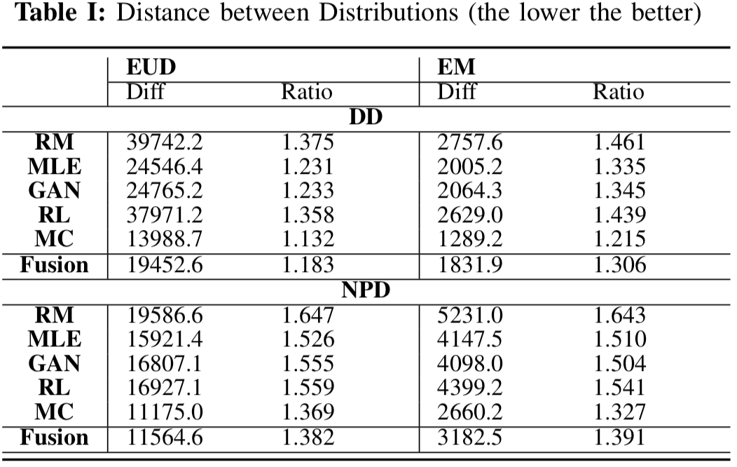
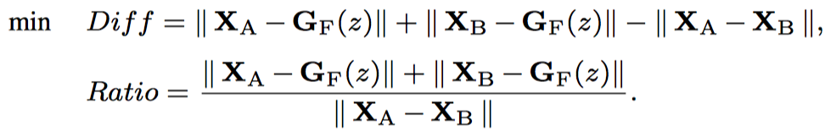
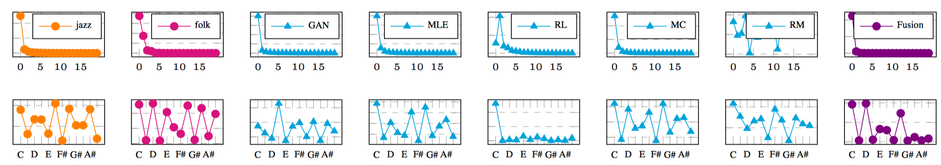
Evaluation
Quantitative Study
F
A
B
Duration Distribution (DD)
Normalized Pitch Distribution

Slide 11
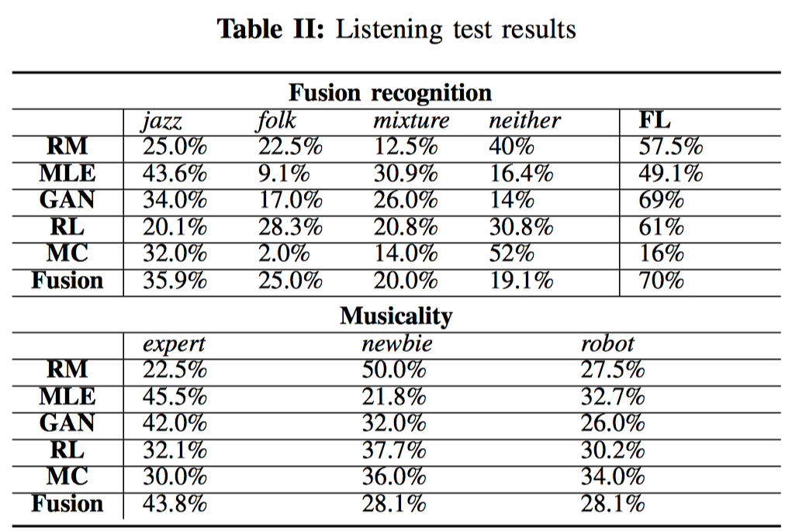
Evaluation
Listening test via user survey
Fusion Level
How much it is thought as fusion music
Given fused music, choose better fusion
pure jazz
pure folk
mixture of jazz and folk
neither
Rate the level of its composer
expert
newbie
robot

Slide 12


Thank you!
Demo
Q&A
Code has been released!
https://github.com/aquastar/fusion_gan

